Slide 1
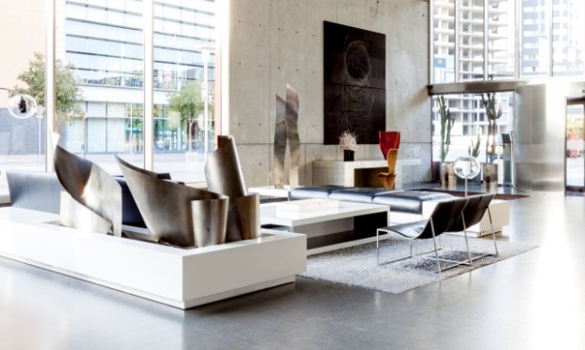

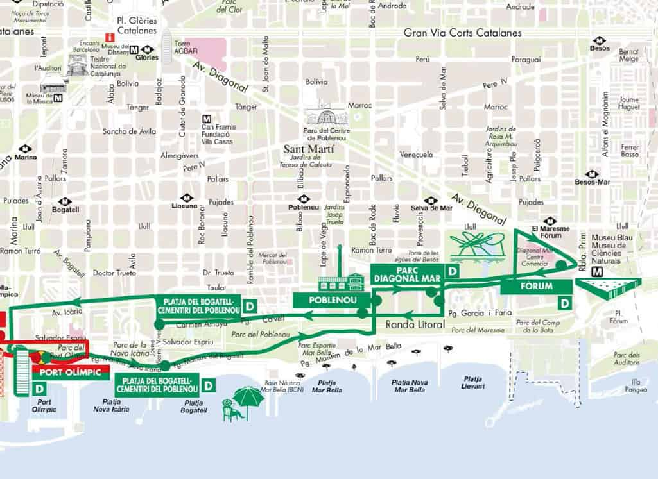
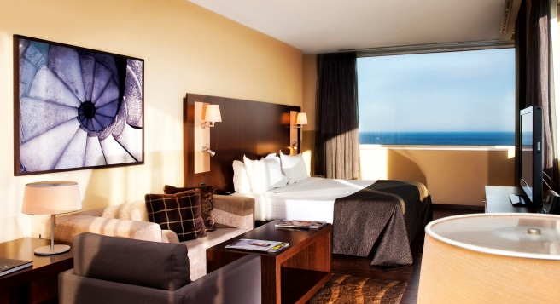
AC HOTEL BARCELONA FÓRUM
ROOM TYPES | Room types | Twin beds | Queen size bed | King size bed | TOTAL
 | Standard room | 156 | 84 | 0 | 240
 | City view room | 16 | 32 | 0 | 48
 | Ocean view rooms | 16 | 16 | 0 | 32
 | Junior Suites | 8 | 0 | 32 | 40
 | Suites | 2 | 0 | 6 | 8
 | TOTAL | 198 | 132 | 38 | 368
Located in the city's new business development area, and featuring 368 rooms and 17 meeting rooms, 2 exhibition halls, AC Hotel Barcelona Forum has positioned itself at the avant-garde of urban hotels for events, conventions, business and pleasure trips. Just 50 m. away from the sea, the hotel enjoys privilege views, along with great comfort and an innovative interior design.
Opening: May 2004 – Refurbish 2016
ROOM DESCRIPTION | STANDARD ROOM
 | TV + 20 Ch. | Yes |  | Bathtube | Yes
 | Heating / Air Conditioning | Yes |  | Shower | Yes
 | Telephone | Yes |  | Hairdyer | Yes
 | Wi-Fi Access | Yes |  | Amenities AC | Yes
 | Safety Box | Yes
PLACES OF INTEREST | TRANSPORT | DISTANCE |  | PLACES | DISTANCE
 | Tram | 10 m. |  | CCIB | 25 m.
 | Metro L-4 | 200 m. |  | Fira Pl. Espanya | 10 km.
 | Bus stop | 50 m. |  | City Center | 4 km.
 | BCN Airport | 15 km. |  | Beach | 50 m.
 | Sants Train St. | 10 km. |  | Sagrada Familia | 4.5 km.
 | Port - Cruises | 7 km. |  | Parc Güell | 7 km.
CITY / OCEAN view rooms: With all the details of the standard rooms
but also with spectacular views over the sea or the city.
JUNIOR SUITES: 48 sq m. with incredible views of the sea or city. Free Wi-Fi
Independent living room with sofa bed to accommodate up to 2 children
under 12 years old. King size bed, snacks for free, sleepers and bathrobe.
SUITES: 62 sq. M. with incredible views over the city and the sea. Jacuzzi,
King size bed, I-pod connection and free Wi-Fi. Special snacks and Nesspresso
coffee maker.
SERVICES | Newspapers | Yes |  | Terrace | Yes
 | TV area | Yes |  | Laundry | Yes
 | Free Wi-Fi Access | Yes |  | Restaurant | Yes
 | Bar | Yes |  | Buffet Breakfast | Yes
 | Parking | Yes |  | Room Service 24h | Yes
 | AC Store | Yes |  | Safety Boxes | Yes
 | Outdoor pool | Yes |  | Concierge | Yes
AC Hotel Barcelona Fórum
Paseo Taulat, 278 – 08019 Barcelona
Tlf.: +34 934 898 200 Fax: +34 934 898 201
hotelacbarcelona.com - acbarcelona@ac-hotels.com

Slide 2
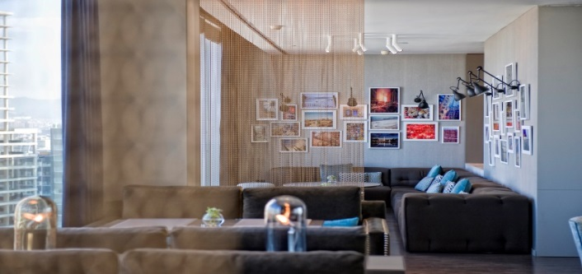
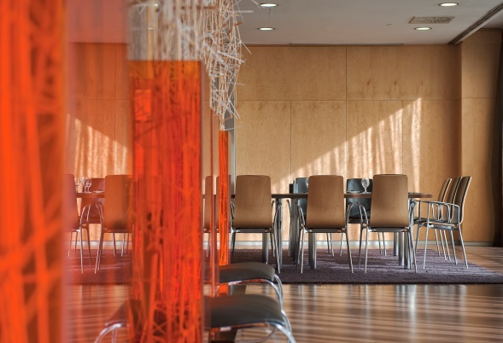
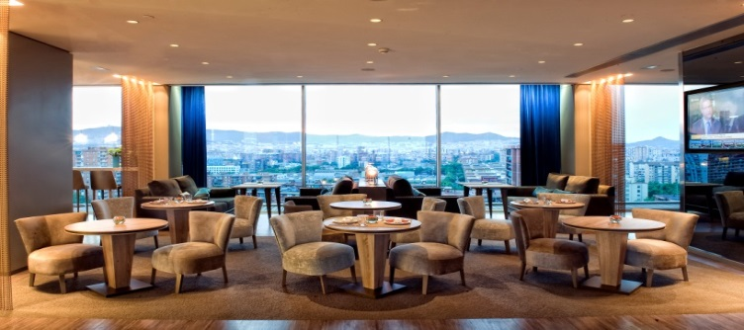
AC HOTEL BARCELONA FÓRUM Convention & Events
Meeting Room | Floor | Natural Light | L x A | Area (m2) | Area (sq ft) | Heigh (m2) | Heigh (ft) | School room | Conference | U Shape | Banquet | Cocktail | Theatre | Crescent Round
Barcelona | 1st | Yes | 24,9 x 10,1 | 220 |  | 3,10 |  | 106 |  |  |  |  | 220
S. Familia | 4th | Yes | 18,7 x 32,8 | 498 | 1.627,30 | 3,90 | 12,80 | 314 | 115 | 105 | 400 | 600 | 560 | 294
Sants | 3rd | No | 13,3 x 6,8 | 94 | 301,84 | 3,50 | 11,48 | 102 | 50 | 42 | 60 | 90 | 126 | 56
Eixample | 3rd | No | 13,5 x 6,8 | 94 | 301,84 | 3,50 | 11,48 | 102 | 50 | 42 | 60 | 90 | 126 | 56
Gràcia | 3rd | No | 13,5 x 6,8 | 94 | 305,12 | 3,50 | 11,48 | 102 | 50 | 42 | 60 | 90 | 126 | 56
Pref. Vert | 3rd | Yes | 16,6 x 12,5 | 260 | 869,20 | 3,30 | 10,83 |  |  |  | 150 | 180
Pref. Blau | 3rd | Yes | 19 x 14,5 | 277 | 869,20 | 3,70 | 10,83 |  |  |  | 150 | 180
Born | 3rd | No | 6,6 x 5,9 | 38 | 127,95 | 2,80 | 9,19 | 21 | 16 | 15 | 20 | 15 | 32 | 14
Montjuic | 3rd | No | 13,3 x 6,7 | 86 | 295,28 | 2,80 | 9,19 | 84 | 42 | 40 | 70 | 90 | 122 | 49
22@ | 3rd | Yes | 18,5 x 9,4 | 176 | 574,15 | 3,30 | 10,83 | 159 | 60 | 51 | 120 | 150 | 250 | 105
Lesseps | 14th | Yes | 7,4 x 3,5 | 26 | 85,30 | 2,50 | 8,20 |  | 14
Putxet | 14th | Yes | 7,4 x 3,5 | 26 | 85,30 | 2,50 | 8,20 |  | 14
Sant Gervasi | 14th | Yes | 7.0 x 6,6 | 46 | 157,48 | 2,90 | 9,51 | 21 | 20 | 20 | 30 | 30 | 35 | 21
Tres Torres | 14th | Yes | 7,0 x 6,6 | 46 | 150,92 | 3,00 | 9,84 | 21 | 20 | 20 | 30 | 30 | 35 | 21
Tibidabo | 14th | Yes | 15,3 x 8,5 | 96 | 285,43 | 3,00 | 9,84 | 28 | 24 | 20 | 60 | 50 | 40 | 30
Vallvidrera | 14th | Yes | 7,3 x 6,1 | 46 | 147,64 | 3,00 | 9,84 | 21 | 20 | 20 | 30 | 30 | 35 | 21
Bonanova | 14th | Yes | 7,1 x 6,7 | 33 | 108,27 | 3,00 | 9,84 | 20 | 16 | 18 | 20 | 20 | 30 | 10
Pedralbes | 14th | Yes | 7,3 x 4,7 | 33 | 114,83 | 2,90 | 9,51 | 20 | 18 | 18 | - | 20 | 30 | 10
Sarrià | 14th | Yes | 7,0 x 5,4 | 38 | 124,67 | 2,50 | 8,20 |  | 14
Meeting rooms equipment ( on request) : Flipchart, A.V. equipments , sound system , laptop computers , wireless internet access , DSL lines , streaming records .
RESTAURANT 4th Floor The "DIA and NIT" Restaurant offers a varied and affordable menu , based on healthy cuisine . Made up delicious salads , original pastas, risottos , vegetables, meats and fish . Your offer is made following the traditional Mediterranean diet.
NATURA LOUNGE 13th Floor The Suite Bar serves up suggestive recipes of our Mediterranean cuisine. Keep up with our weekly gastronomic offering or taste the famous Mediterranean Bluefin tuna . It is the perfect corner to spend a nice time and also for sport fans and spectators
AC Hotel Barcelona Fórum
Paseo Taulat, 278 – 08019 Barcelona
Tlf.: +34 934 898 200 Fax: +34 934 898 201
hotelacbarcelona.com - acbarcelona@ac-hotels.com

